Slide 1
Android Lights
Mobile Systems Programming.
Group 6.

Slide 2
1. Motivation
Android-Phillips HUE App store is pretty much saturated.
Lots of applications that only perform one simple notification task.
“Why should I need an app for each type of notification?”

Slide 3
2. Objective
“We wanted to create an app that could be complex enough to cover some of the most used notification services that were already implemented separately, but also simple enough that you won’t notice the difference between its single-feature app counterpart”

Slide 4
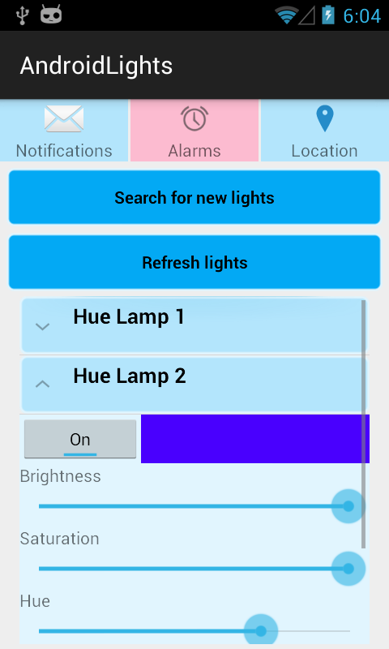
3. Result
App that customizes your notifications through lights.
Notifications types:
Alarms.
Location.
Custom Notifications.

Slide 5
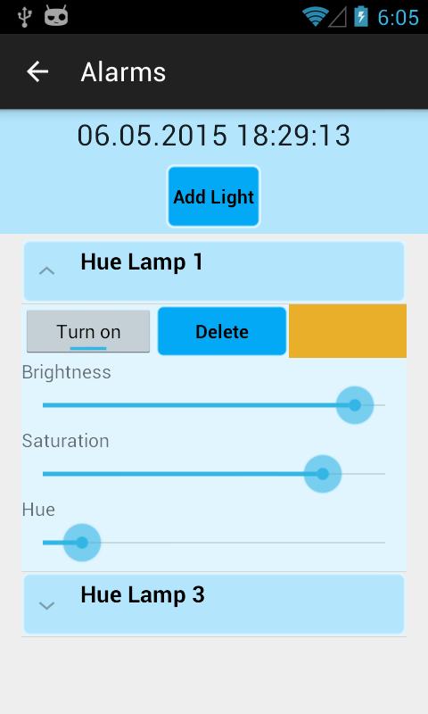
4. Features: Alarm notifications.
Changing the bulb settings time-based
Affect multiple bulbs
Possible use cases:
Pretend being at home
Visual alarm clock

Slide 6
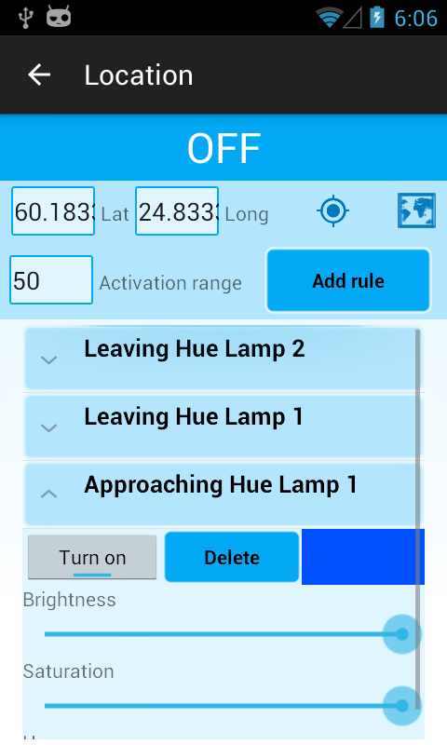
5. Features: Location notifications.
Fully automated light control
Lights turn on/off depending on the current location
Full control of brightness, saturation and hue of each bulb
Convenience
Target area can be set from map or the current location
can be used
Every bulb can have its own set of rules and settings
Possible use cases
Turn off all lights after leaving home
Set home lighting when commuting home from work
Benefits
Cost savings when the bulbs aren’t left on unintentionally

Slide 7
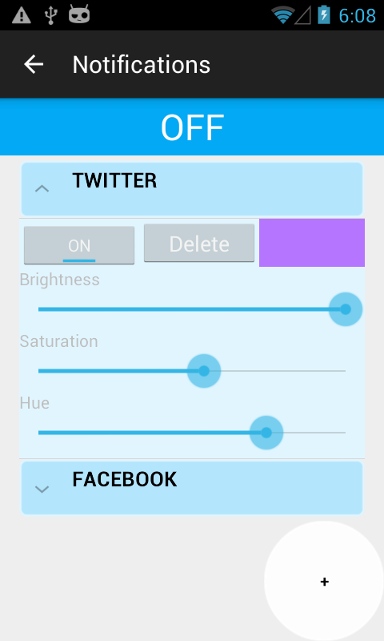
6. Features: Custom Notifications.
Custom notifications depending on the application
Notification from social networking application
- Facebook, WhatsApp, Instagram, Twitter, Gmail.
User friendly and Simplified UI for the user
to have better experience

Slide 8
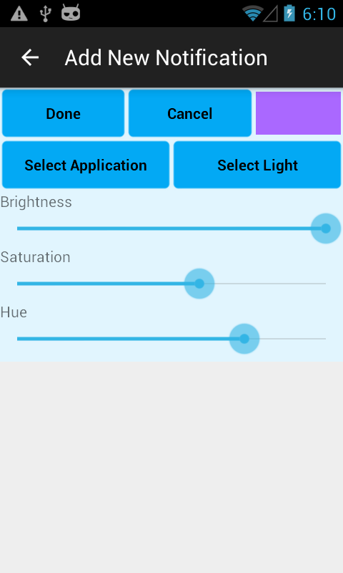
6. Features: Custom Notifications.
Customisation:
Select application
Select colour
Select lights
Turn On / Off notification for individual application
Turn On / Off this feature as a whole

